Slide 1
Pembelajaran Mesin dan Pembelajaran Mendalam #5 Introduction to Deep Learning
Semester Gasal 2024/2025
Prodi Informatika
Universitas Atma Jaya Yogyakarta

Slide 2
Outline
Deep Learning
Artificial Neural Network
Multi Layer Perceptron

Slide 3

Deep Learning

Slide 4
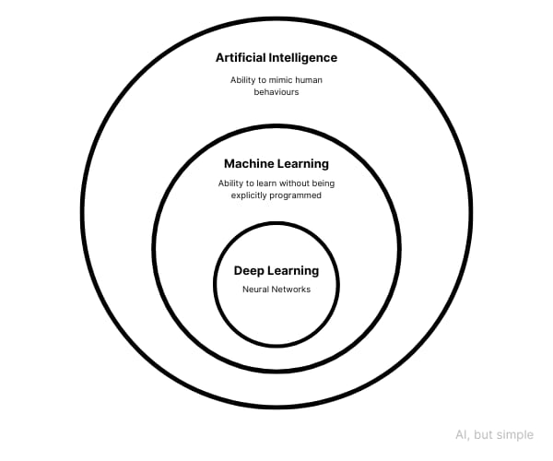
Deep Learning in AI

Slide 5

Deep Learning | What is Deep Learning? | Deep Learning Tutorial For Beginners | 2023 | Simplilearn
https://youtu.be/6M5VXKLf4D4?si=ZBgxWot9CCKpSHkR

Slide 6
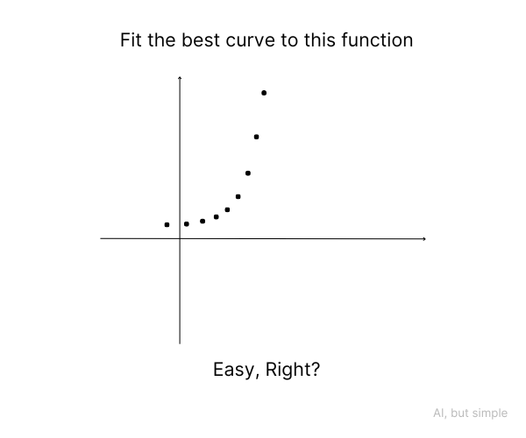
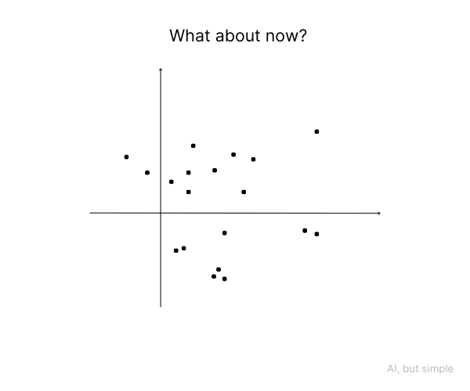
Deep Learning in AI
Neural networks
a means of learning how to perform a task by analyzing training examples

Slide 7
Artificial Neural Network

Slide 8
Perceptron
A simple type of artificial neural network that was devised by Frank Rosenblatt in 1957.
Inspired by cognitive science and neuroscience.
Perceptron formula:
A mathematical expression that outputs 1 or 0 depending on whether the sum of the coefficient vector and the bias term is positive or negative.
y = sign(Xw + b)

Slide 9
y = sign(Xw + b)
X: matrix of numerical values, and you can't use any symbols as input unless you convert them to numbers first.
Weights (W) and bias (b): The perceptron multiplies X by the weights and adds the bias.
Summarization of results: when multiplying X by the w vector, matrix multiplication is used.
Activation function (sign): When the summation of the input reaches a threshold, the perceptron activates a result of the input being part of the class.
Iterative learning of the best set of vector w values: the answer is based on consecutive approximations based on a comparison between perceptron output and intended result.

Slide 10
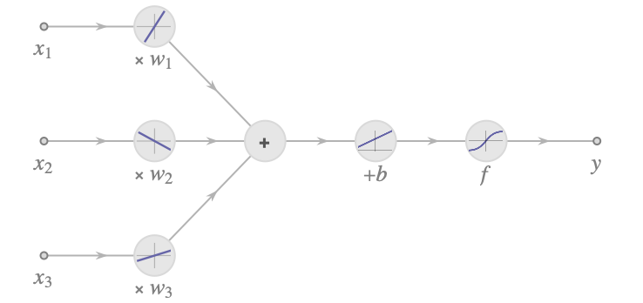
y = sign(Xw + b)

Slide 11
Artificial Neural Network
ANN is a part of AI developed by the connectionist group.
ANN processes multiple inputs through several layers, yielding multiple outputs. (Perceptron can only choose between two outputs.)
ANN can be used for classification, regression, clustering, etc.

Slide 12
Activation Functions
Various activation functions exist in neural networks.
The Binary Step function is rarely used due to its limitations.
Frequently used activation functions include Sigmoid (Logistic), Hyperbolic Tangent (TanH), and ReLU (most popular).

Slide 13
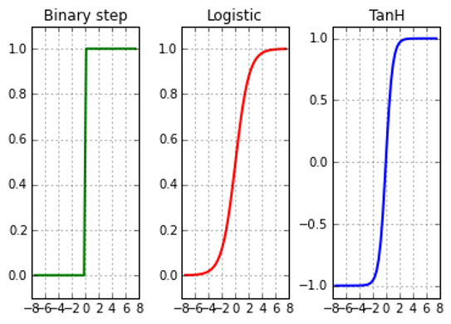
Activation Functions
The diagram illustrates how an input (horizontal axis) affects an output (vertical axis).
These functions perform effectively within specific ranges of x values.
Always rescale inputs using statistical normalization (zero mean, unit variance) or normalize to a range of 0 to 1 or -1 to 1.

Slide 14
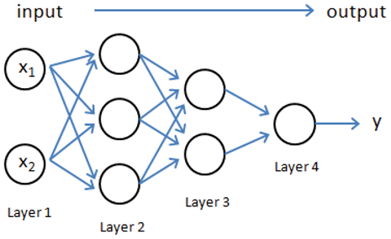
How Neural Networks Works
Input Layer: The first layer gathers features from each data sample.
Output Layer: The final layer produces the outcomes.
Neural networks only process continuous numerical data, not qualitative variables.
When handling binary values, neurons treat them as numerical and can convert them into other values, including negative ones.

Slide 15
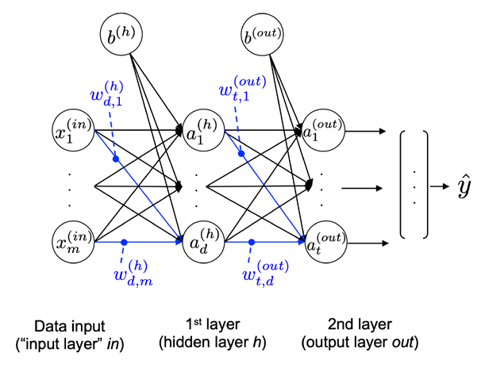
How Neural Networks Works
The NN structure consists of:
the nodes on the left represents the input feature
lines that connect perceptron nodes as learned coefficients or weights
hidden layer as an additional stage in calculations that contains many perceptron units
the rightmost node is the output layer

Slide 16
How Neural Networks Works
Learning Process: The model learns patterns from training data, starting at the input layer to produce an output.
Perceptron Functionality: Each perceptron calculates a weighted sum of inputs from the previous layer, applies an activation function, and passes the output to the next layer.
Loss Calculation: The "loss" is computed using a loss function, representing the difference between the predicted output and the actual label. The goal is to minimize this loss. (y hat – y true)

Slide 17
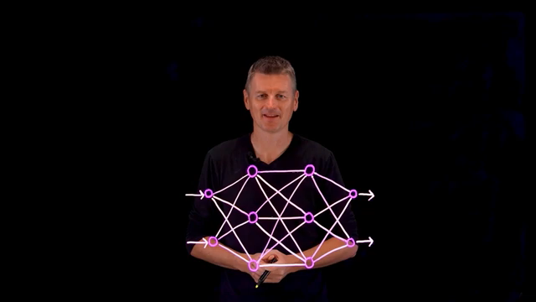
Neural Networks Explained in 5 minutes
https://youtu.be/jmmW0F0biz0?si=mwuFUp96UJwMN7xL

Slide 18
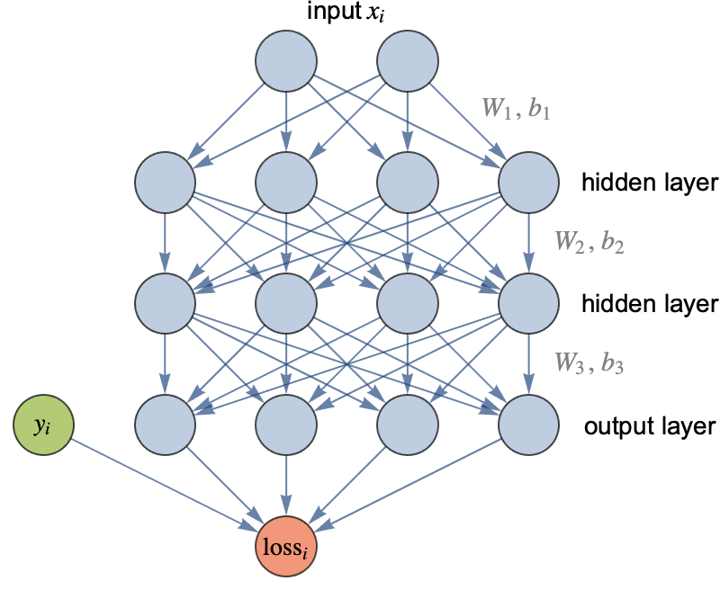
Loss

Slide 19
How Neural Networks Works
Weight and Bias Update: Weights and biases for each perceptron are updated using backpropagation and derivatives.
Epochs: After several epochs of training, appropriate weights and biases are obtained.
Forward Propagation: This process calculates the network output, applying the activation function to predict class labels.

Slide 20
Loss function: Cross-entropy
Loss Minimization: The goal is to minimize loss; a better model results in lower loss. For a perfect model, cross-entropy loss equals 1.
Classification Use: Cross-entropy loss is suitable for binary (0 or 1) and multiclass classification problems.
Error Penalization: It calculates the loss between real and predicted labels, penalizing incorrect predictions more heavily, helping the model learn from mistakes. For example, predicting 0.01 instead of 0.99 for a true label of 1 results in a higher loss.

Slide 21
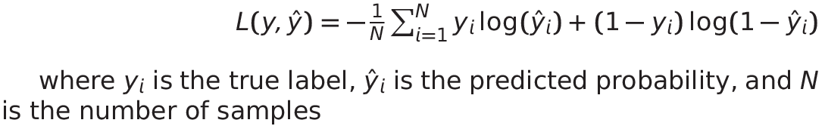
Cross-entropy types
Loss Functions: Various loss functions assess the difference between actual and predicted probability distributions, including binary cross-entropy, categorical cross-entropy, and sparse cross-entropy.
Binary Cross-Entropy: Used when outcomes are 0 or 1 for binary classification tasks, such as spam detection.

Slide 22
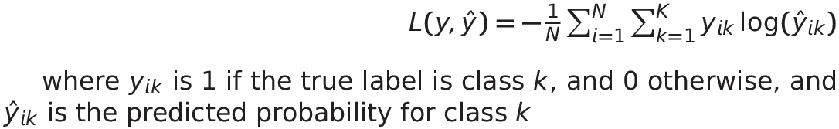
Cross-entropy types
Categorical Cross-Entropy: Used when outputs belong to one of K classes (more than two classes).
Application: Suitable for multi-class classification tasks, such as image recognition (e.g., identifying dogs, cats, or birds).

Slide 23
Cross-entropy types
Sparse Cross-Entropy: A variation of categorical cross-entropy used when labels are represented as integers instead of one-hot vectors.
Label Encoding: For a 3-class problem, labels would be 0, 1, or 2 instead of one-hot representations like [1, 0, 0].

Slide 24
Gradient Descent
Minimization Method: Used for functions with continuous numeric inputs, such as neural network cost functions.
Basic Idea: Begin at an initial point and follow the steepest descent direction to reach a minimum.

Slide 25
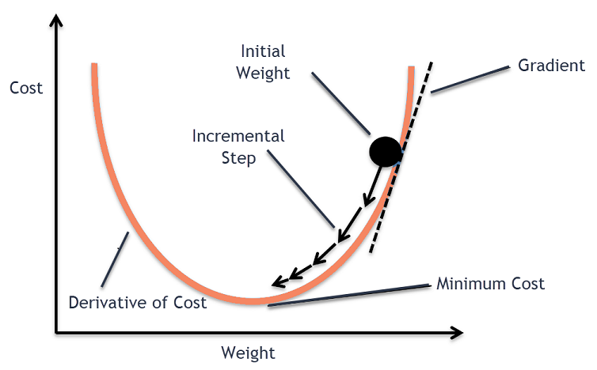
Gradient Descent

Slide 26
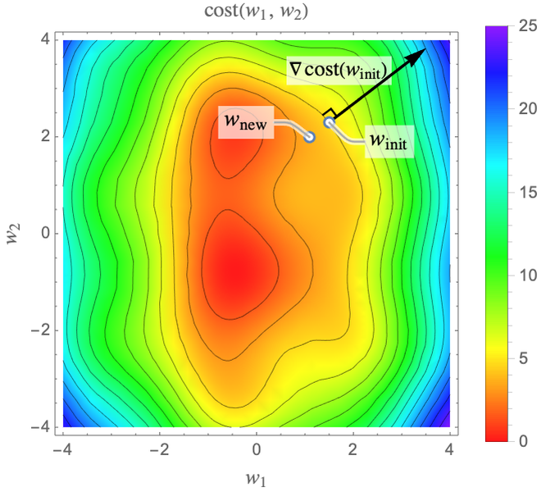
Gradient Descent

Slide 27
Learning Rate
Parameter that provides the model a scale of how much model weights should be updated
Using a good learning rate is important.
If the learning rate is too small, the convergence will be too slow, and if it is too large, the procedure might not even converge.

Slide 28
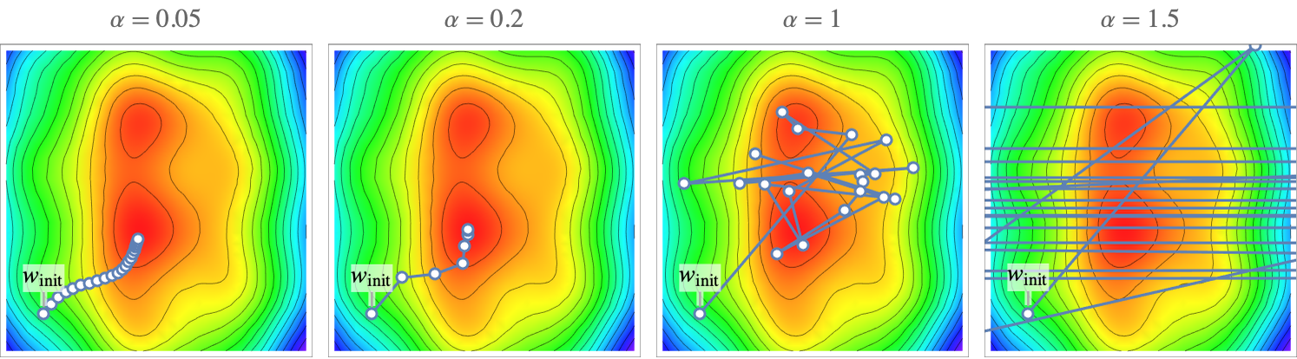
Learning Rate

Slide 29
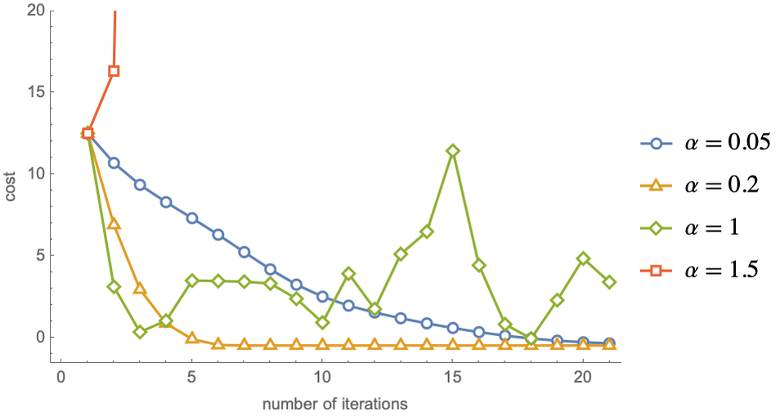
Learning Rate

Slide 30
Optimization in NN
Optimization in NN refers to the process of adjusting weights and biases to minimize the objective function known as the cost function (average loss function).
This process is usually carried out using the gradient descent technique.
Loss function: https://youtu.be/QBbC3Cjsnjg
Optimizer: https://youtu.be/mdKjMPmcWjY

Slide 31
Multi Layer Perceptron

Slide 32
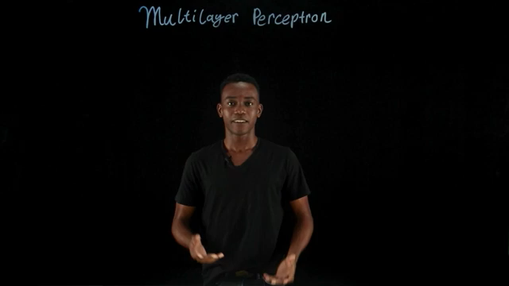
What are MLPs (Multilayer Perceptrons)?
https://youtu.be/7YaqzpitBXw?si=9mqXo-83y-15eJJt

Slide 33
Multi Layer Perceptron (MLP)
An MLP is a type of feedforward artificial neural network, composed of at least three layers:
an input layer,
one or more hidden layers,
and an output layer
From a mathematical perspective, MLPs are just a set of functions where each layer applies transformations to an input to produce a corresponding output.

Slide 34
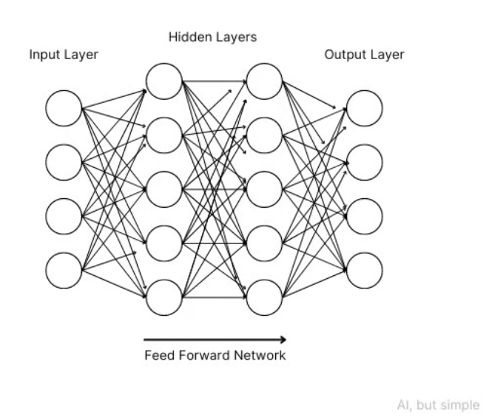
Multi Layer Perceptron

Slide 35
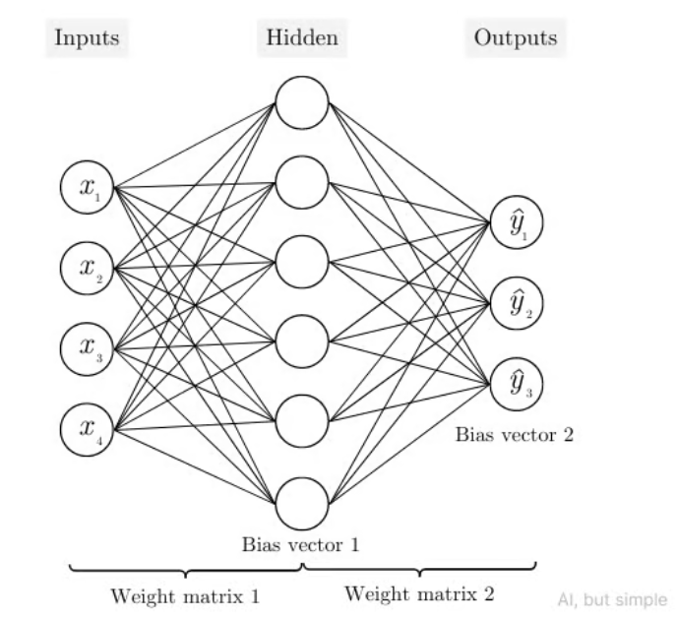
Multi Layer Perceptron

Slide 36
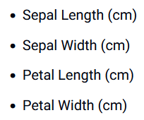
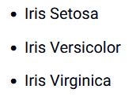
Multi Layer Perceptron

Slide 37
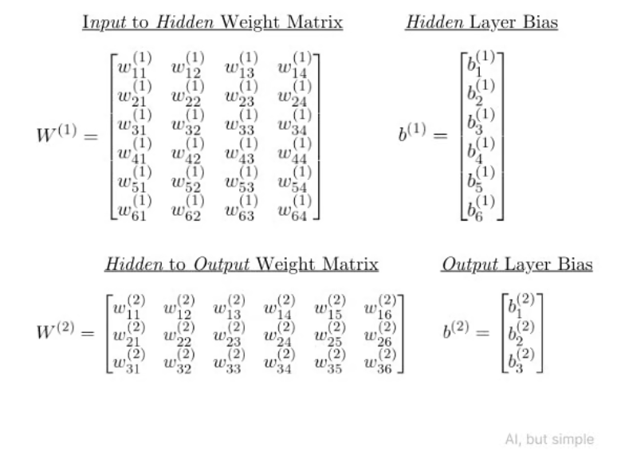
Multi Layer Perceptron

Slide 38
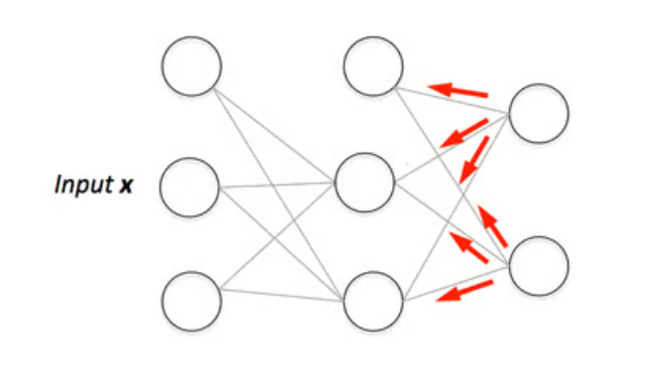
Backpropagation and Learning in MLP
Training Process in MLP
Randomly initialize weights and biases
Forward Propagation
Compute Loss
Backward Propagation
Compute the gradients of the loss with respect to weights and biases
Update Weights and Biases
Use an optimization algorithm like Gradient Descent to update the weights and biases
Repeat

Slide 39
Code example: MLP scikit-learn
import numpy as np
from sklearn import datasets
from sklearn.model_selection import train_test_split
from sklearn.neural_network import MLPClassifier
from sklearn.metrics import accuracy_score
# Load the Iris dataset
iris = datasets.load_iris()
X = iris.data
y = iris.target
# Split the dataset into training and testing sets
X_train, X_test, y_train, y_test = train_test_split(X, y, test_size=0.2, random_state=42)

Slide 40
Code example: MLP scikit-learn
# Create and train the MLP classifier
mlp = MLPClassifier(hidden_layer_sizes=(10, 10), max_iter=1000, random_state=42)
mlp.fit(X_train, y_train)
# Make predictions
y_pred = mlp.predict(X_test)
# Evaluate the model
accuracy = accuracy_score(y_test, y_pred)
print(f'Accuracy: {accuracy:.2f}')

Slide 41
Code example: MLP Tensorflow
import numpy as np
import tensorflow as tf
from sklearn import datasets
from sklearn.model_selection import train_test_split
from sklearn.preprocessing import StandardScaler
from sklearn.preprocessing import OneHotEncoder
# Load the Iris dataset
iris = datasets.load_iris()
X = iris.data
y = iris.target.reshape(-1, 1) # Reshape for one-hot encoding
# One-hot encode the labels
encoder = OneHotEncoder(sparse=False)
y_encoded = encoder.fit_transform(y)
# Standardize the features
scaler = StandardScaler()
X_scaled = scaler.fit_transform(X)
# Split the dataset into training and test sets
X_train, X_test, y_train, y_test = train_test_split(X_scaled, y_encoded, test_size=0.2, random_state=42)

Slide 42
Code example: MLP Tensorflow
# Create the MLP model
model = tf.keras.Sequential([
tf.keras.layers.Dense(10, activation='relu', input_shape=(X_train.shape[1],)),
tf.keras.layers.Dense(10, activation='relu'),
tf.keras.layers.Dense(3, activation='softmax') # 3 classes for iris
])
# Compile the model
model.compile(optimizer='adam', loss='categorical_crossentropy', metrics=['accuracy'])
# Train the model
model.fit(X_train, y_train, epochs=100, batch_size=32, verbose=0)
# Evaluate the model
loss, accuracy = model.evaluate(X_test, y_test)
print(f'Accuracy: {accuracy:.2f}')

